Slide 1
ML with FFT
Presented by Youssef CHAFIQUI

Slide 2
FFT and PCA Approach
The idea is to extract features from images using FFT and to use these features for ML prediction.
To evaluate the effectiveness of the proposed approach, I have trained a list of ML models with and without FTT, and then compared the results.
Pass the whole flattened FFT matrix to the ML models (input size = image height * width)
Apply PCA to the FFT matrix with one component (input size = image height)

Slide 3
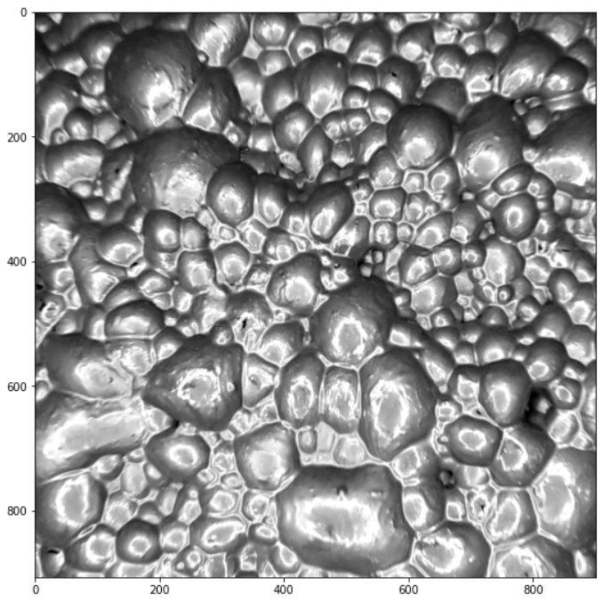
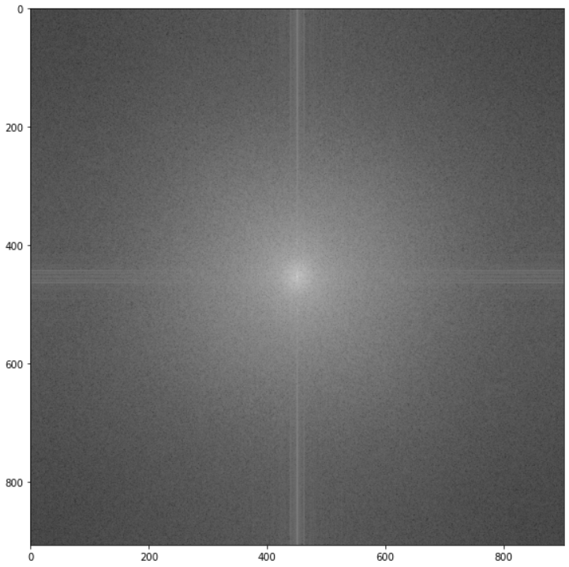

FFT and PCA Approach
FFT
PCA

Slide 4
Classification: Cats vs. Dogs
 | Without FFT |  | With FFT |  | FFT and PCA
 | Accuracy | F1 score | Accuracy | F1 score | Accuracy | F1 Score
Logistic Regression | 0.38 | 0.39 | 0.63 | 0.65 | 0.61 | 0.63
SVM | 0.57 | 0.59 | 0.66 | 0.70 | 0.58 | 0.61
Random Forest | 0.5 | 0.47 | 0.65 | 0.68 | 0.58 | 0.62
XGBoost | 0.47 | 0.48 | 0.67 | 0.71 | 0.63 | 0.64

Slide 5
Froth flotation Relavage Pb 4 only
10 videos (638 images) for training. Approx. 60 images per video.
Images of the same video have the same labels.
The solution was to introduce some noise to the labels
A random offset (0 < offset < r) was added to the labels of images of the same video.
r = 1
2 videos for testing (Average prediction of all images of the video compared with real labels).

Slide 6
Froth flotation: models trained
 | Without FFT |  |  |  | With FFT |  |  |  | FFT and PCA
 | MAE | MSE | R2 | Time (s) | MAE | MSE | R2 | Time (s) | MAE | MSE | R2 | Time (s)
Linear Regression | 3.06 | 20.05 | -3.73 | 113.35 | 2.34 | 9.71 | -1.48 | 110.18 | 3.008 | 19.95 | -2.94 | 0.38
SVM | 2.58 | 10.72 | -2.10 | 186.75 | 2.29 | 7.90 | -2.22 | 179.78 | 2.46 | 9.87 | -2.24 | 9.41
XGBoost | None | None | None | > 1h | 2.84 | 15.56 | -2.16 | 2079.5 | 2.98 | 16.58 | -2.43 | 0.60
Random Forest | None | None | None | > 1h | None | None | None | > 1h | 2.76 | 12.47 | -1.73 | 314.10
Catboost | None | None | None | > 1h | None | None | None | > 1h | 2.69 | 11.40 | -1.53 | 1.65

Slide 7
Froth flotation models trained
 | FFT and PCA
 | MAE | MSE | R2 | Train Time (s)
Linear Regression | 3.008 | 19.95 | -2.94 | 0.38
SVM | 2.46 | 9.87 | -2.24 | 9.41
XGBoost | 2.98 | 16.58 | -2.43 | 0.60
Catboost | 2.76 | 12.47 | -1.73 | 314.10
Random Forest | 2.69 | 11.40 | -1.53 | 1.65

Slide 8
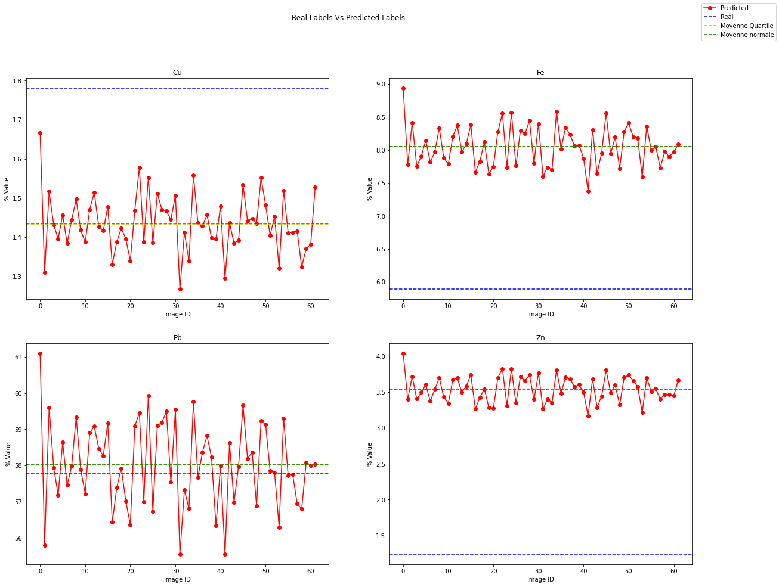
SVM results on test video #1

Slide 9
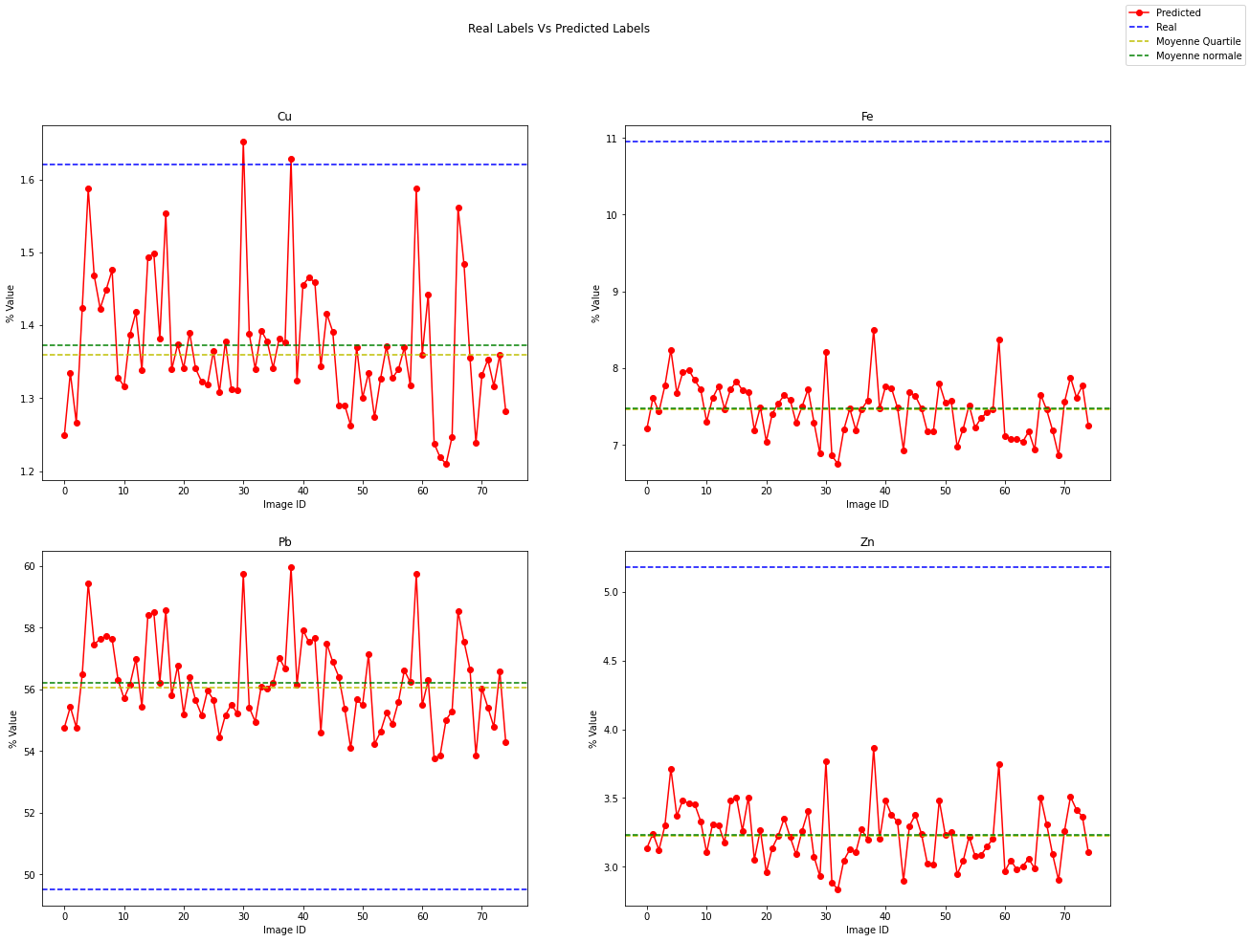
SVM results on test video #2

Slide 10
Froth flotation models evaluation (Average of two test videos)
 | Average Prediction % - Actual %
 | Cu | Fe | Pb | Zn
SVM | 0.3 | 2.82 | 3.39 | 2.12
Random Forest | 0.2 | 2.975 | 4.555 | 2.02
XGBoost | 0.12 | 3.16 | 4.065 | 2.05
Catboost | 0.205 | 3.01 | 4.595 | 1.995

Slide 11
Froth flotation: Relavage Pb 1, 3 and 4
24 videos (1559 images) for training.
5 videos for testing (Average prediction of all images of the video compared with real labels).
 | Average Prediction % - Actual % (average of 5 test videos)
 | Cu | Fe | Pb | Zn
SVM | 0.84 | 4.15 | 13.49 | 1.36
Random Forest | 0.83 | 3.39 | 10.04 | 1.51
XGBoost | 0.86 | 3.39 | 8.94 | 1.57
Catboost | 0.79 | 3.18 | 9.51 | 1.43

Slide 12
Froth flotation: Relavage Pb 1, 3 and 4
A random offset (0 < offset < r) was added to the labels of images of the same video.
Cu: r = 1.8 | Fe: r = 1.6 | Pb: r = 0.5 | Zn: r = 1.6
 | Average Prediction % - Actual % (average of 5 test videos) |  |  |  | MAE | MSE
 | Cu | Fe | Pb | Zn
SVM | 0.77 | 4.08 | 13.45 | 1.21
Random Forest | 0.72 | 3.34 | 9.98 | 1.31
XGBoost | 0.71 | 3.26 | 9.39 | 1.30
Catboost | 0.79 | 3.14 | 9.69 | 1.21

Slide 13
Froth flotation: Relavage Pb 1, 3 and 4 (2 components for PCA)
 | Average Prediction % - Actual % (average of 5 test videos)
 | Cu | Fe | Pb | Zn
SVM | 0.788315 | 3.883035 | 12.880749 | 1.177205
Random Forest | 0.693605 | 3.137268 | 8.380914 | 1.250317
XGBoost | 0.727500 | 2.947093 | 7.633041 | 1.209546
CatBoost | 0.726113 | 2.882670 | 8.050951 | 1.190892
Gradient Boosting | 0.692462 | 2.988582 | 8.174781 | 1.163140
AdaBoost | 0.806758 | 3.763127 | 9.397196 | 1.295960
Decision Tree | 0.793053 | 3.438324 | 10.125517 | 1.152084
KNN | 0.812097 | 3.082230 | 6.638384 | 1.202826
Neural Network | 0.824419 | 2.669737 | 9.046821 | 1.520403

Slide 14
Thank You

